Slide 1

CPI, MIGRATION, AND HOME PRICE ANALYSIS
Group 4:
Alexander Iluridze
Gabriel Morano
Jack Richey

Slide 2

INTRODUCTION
Hypothesis: If migration and inflation in certain states has significantly increased, then home values within those states will also have significantly increased.
Core Questions: What is the impact of migration and inflation on housing prices? Are these factors correlated? Are certain states more impacted than others? What are the common trends between these three factors over the last 10 years?
Motivations: The last five years have been an economic roller coaster. Understanding the trends in inflation, migration, and housing prices and their interrelatedness could serve to aid in making effective financial decisions and bolster preparedness for what is to come.

Slide 3
Data Sources
Consumer Price Index (CPI) & Inflation
Department of Finance
Data.texas.gov
Bureau of Labor Statistics
Housing Price Index (HPI), median home prices, and geographical data
Federal Housing Finance Agency
Zillow (median house prices)
Simplemaps.com (coordinates)
Migration
Census.gov

Slide 4
INFLATION
Calculated as the percent change of the Consumer Price Index

Slide 5
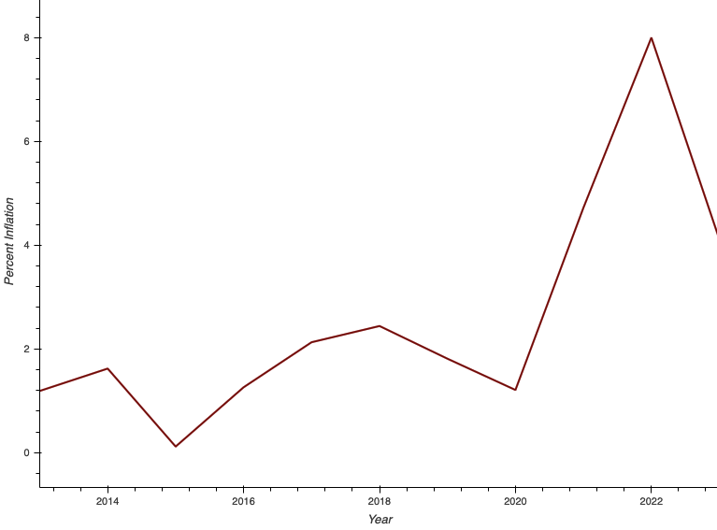
US INFLATION 2012 - 2023
INFLATION RATE
2015: 0.12%
2022: 8.00%
2023: 4.12%

Slide 6
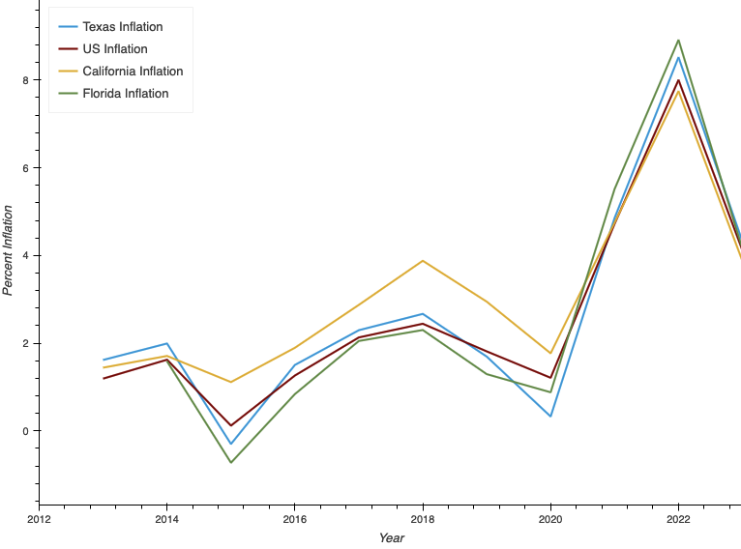
US, FL, TX & CA INFLATION
2022 INFLATION RATE
US: 8.00%
FLORIDA: 8.92%
TEXAS: 8.52%
CALIFORNIA: 7.75%

Slide 7
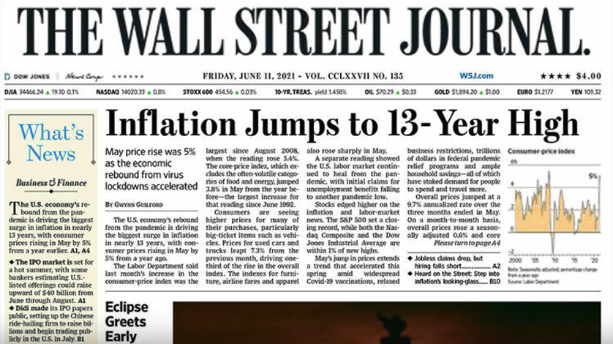
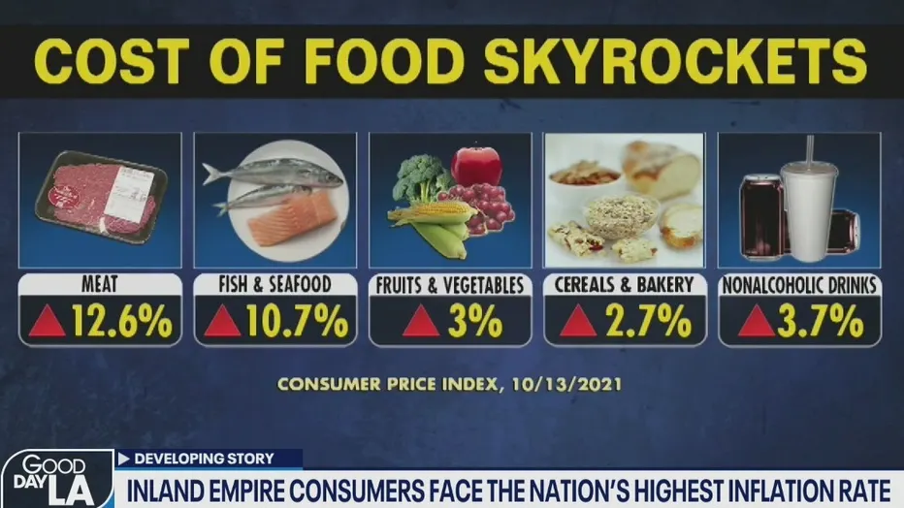

HEADLINES FROM 2021

Slide 8
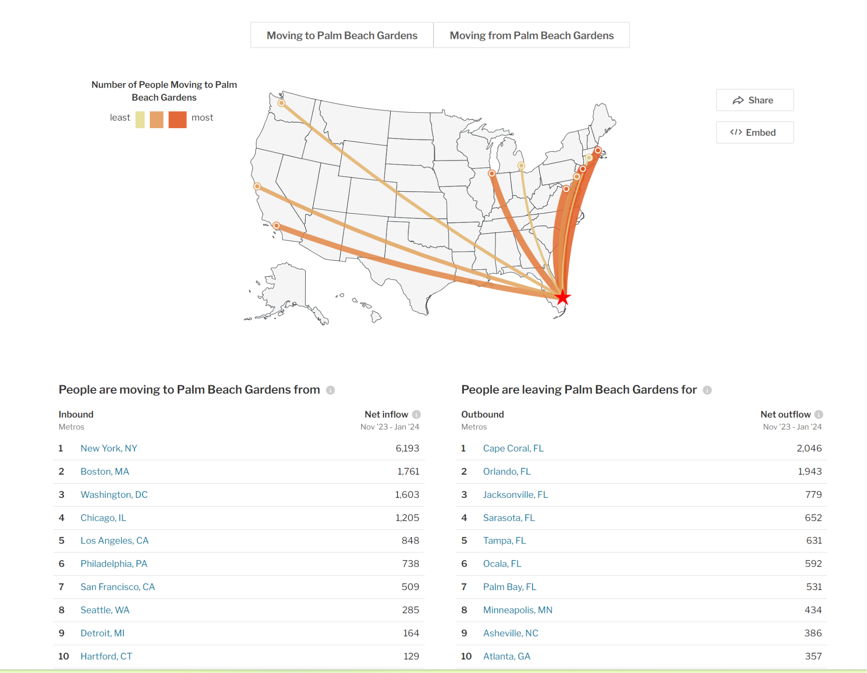
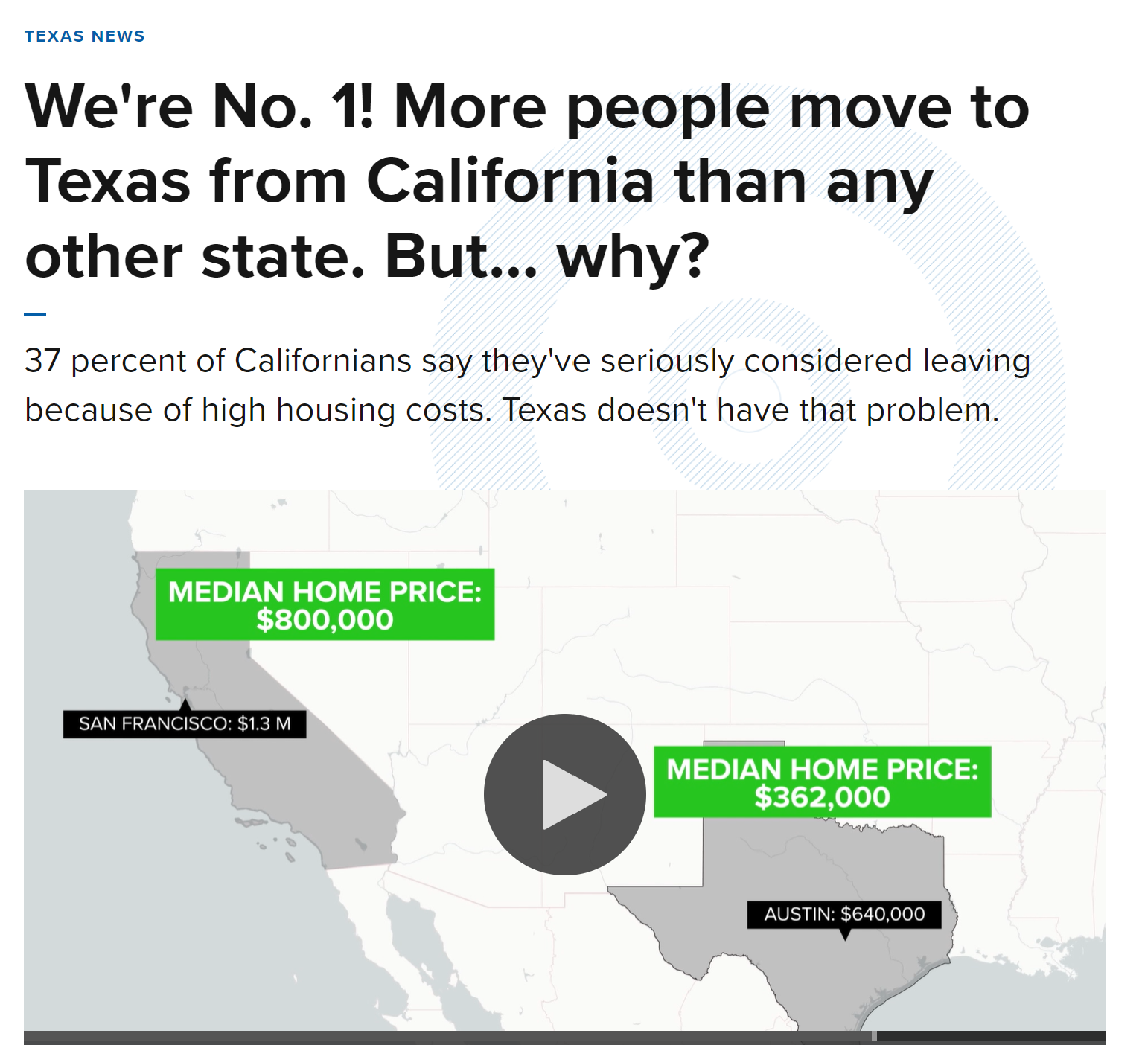
Effects of the Pandemic
At-home work.
Higher mobility (less dependent on job’s geographical location).
Relocation to the South-East states from high housing cost markets.
US Residents Flocking to Texas Are Driving Up Home Prices in the Lone Star State
Fed up with California’s soaring home prices, a whopping 111,000 people made the move from the Golden State to Texas in 2021, making it the most popular relocation route in the country.
“A lot of people were getting priced out of Austin and started moving into San Antonio,” local real estate agent, Marie Crabb, told the WSJ. “They were getting priced out, according to them, by people from California. It was an interesting trickle-down effect.”
Cause for Worry? Texas Housing Market in Crisis: The Californian Invasion Pushes Prices to Sky-High Levels
The Texas housing market is facing affordability issues due to a significant influx of migrants from more expensive states, predominantly California.
The Federal Housing Finance Agency reported a 20% year-over-year increase in Texas home values early in 2022, a spike comparable to California’s housing market in the mid-2000s.
The Ripple Effect (San Antonio)

Slide 9
US MIGRATION 2012 - 2022

Slide 10
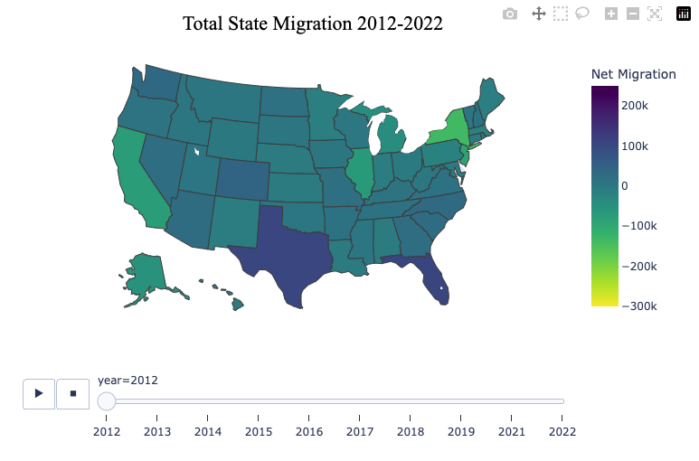
TOTAL STATE MIGRATION | 2012
State | Net Amount
California | -73,345
Texas | 105,565
Florida | 108,823
New York | -135,811
Illinois | -69,198

Slide 11
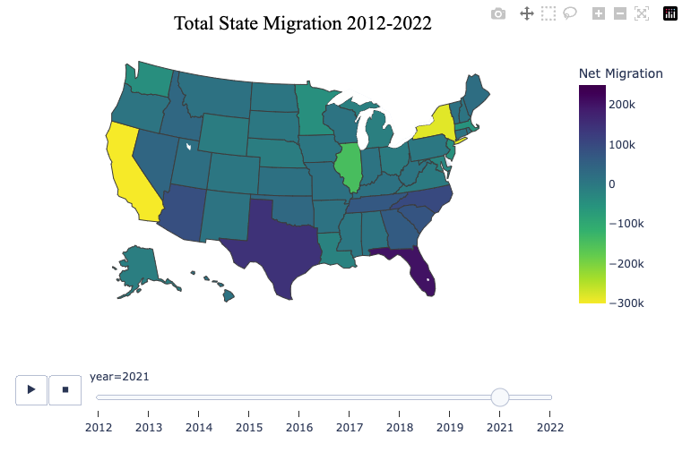
TOTAL STATE MIGRATION | 2021
State | Net Amount
California | -407,663
Texas | 144,032
Florida | 205,163
New York | -283,792
Illinois | -146,248

Slide 12
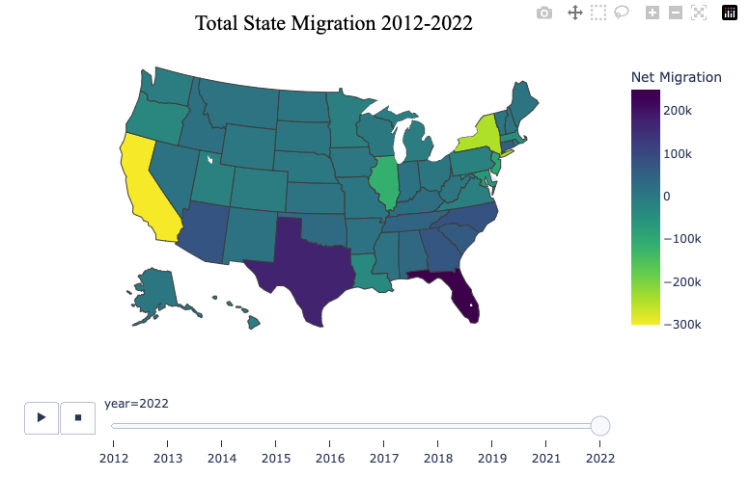
TOTAL STATE MIGRATION | 2022
State | Net Amount
California | -341,866
Texas | 174,261
Florida | 249,064
New York | -244,137
Illinois | -115,719

Slide 13
2021-2022 NET MIGRATION TOTALS
State | Net Amount
California | -749,529
Texas | 318,293
Florida | 454,227
New York | -527,929
Illinois | -261,967
California loses a senate seat for the first time due to mass exodus
Christopher, Ben. California Loses Congress Seat for the First Time. CalMatters. April 26, 2021. https://calmatters.org/politics/2021/04/california-congress-census/
Texas gains two senate seats
Ura, Alexa. Texas Will Gain Two Seats in Congress as Residents of Color Drive Population Gains. Texas Tribune. April 26, 2021. https://www.texastribune.org/2021/04/26/texas-congress-seats-gain/
Florida gains one senate seat
The Associated Press. Florida Gains Another Congressional Seat Thanks to Population Boom. WFLA. April 26, 2021. https://www.wfla.com/news/florida/florida-gains-another-congressional-seat-thanks-to-population-boom/

Slide 14
HOUSE PRICE INDEX
Tracks changes in single-family homes values year-to-year

Slide 15
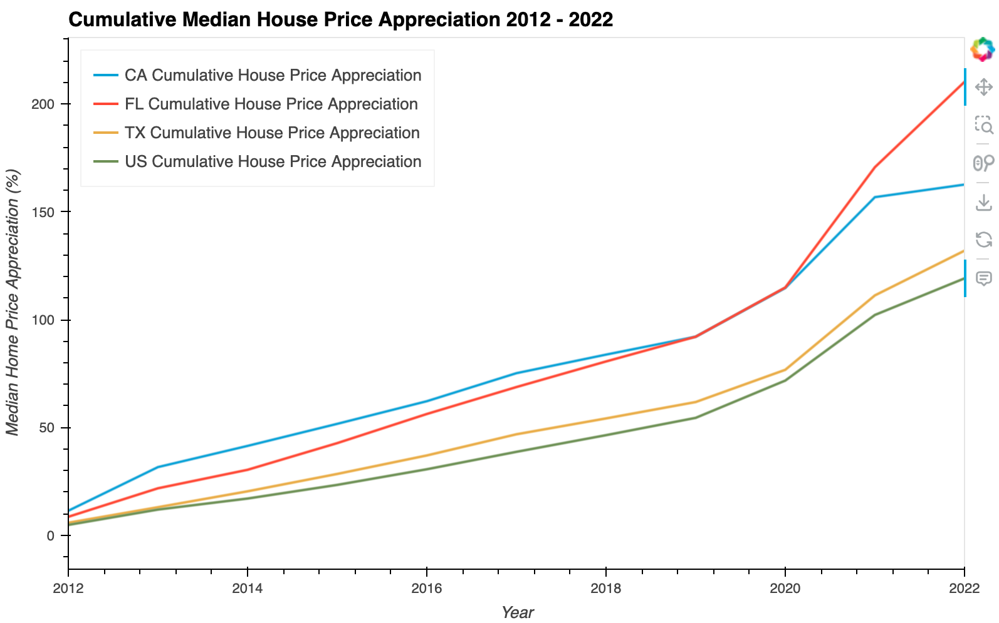
CUMULATIVE MEDIAN HOUSE PRICE APPRECIATION 2012-2022
State | 2021 | 2022
CA | 157% | 162%
FL | 170% | 210%
TX | 111% | 132%
USA | 102% | 119%
Data Entry Information here…

Slide 16
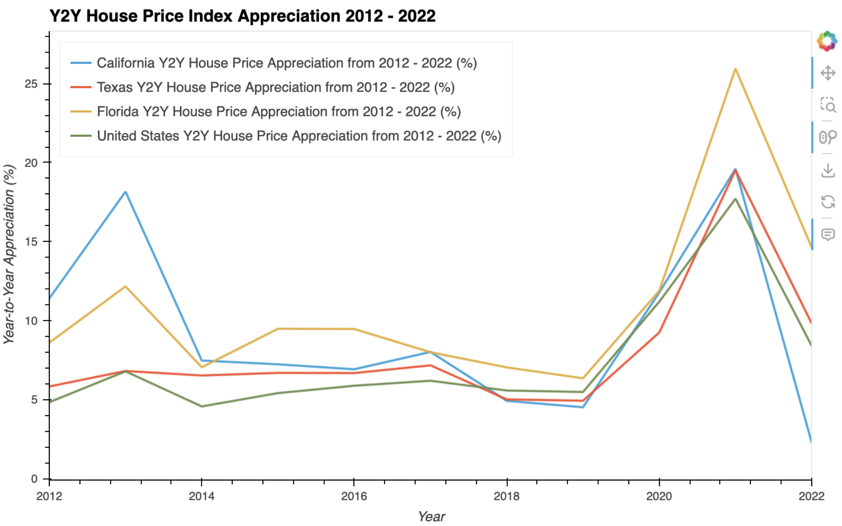
Y2Y HOUSE PRICE INDEX APPRECIATION 2012-2022
Percent rounded up to nearest tenth
State | 2012 | 2021 | 2022
CA | 11.4 | 19.6 | 2.3
FL | 8.6 | 26 | 14.6
TX | 5.8 | 19.5 | 9.8
USA | 4.8 | 17.7 | 8.4
Data Entry Information here…

Slide 17
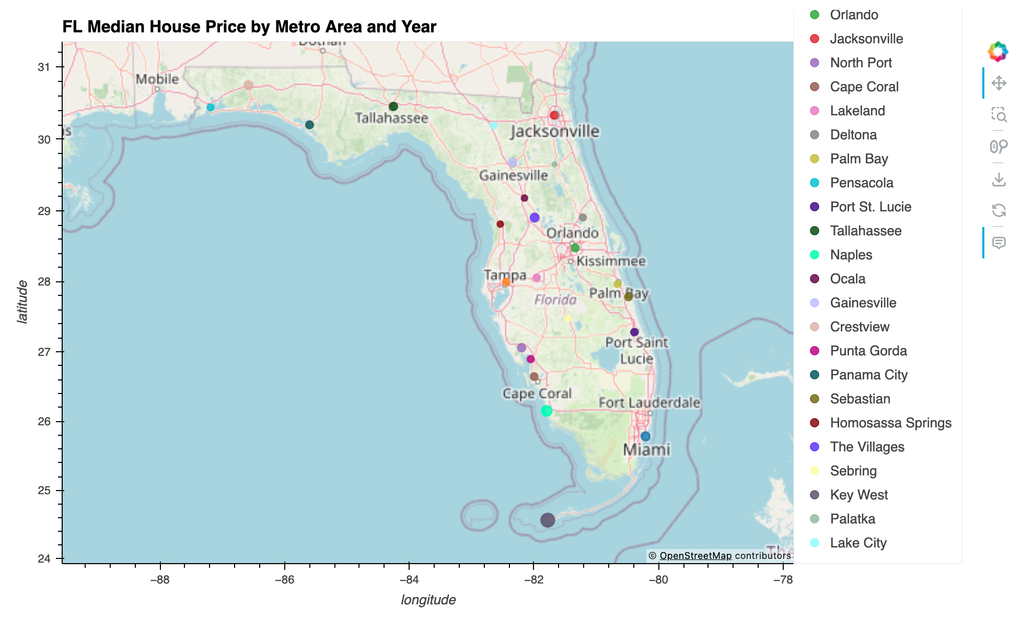
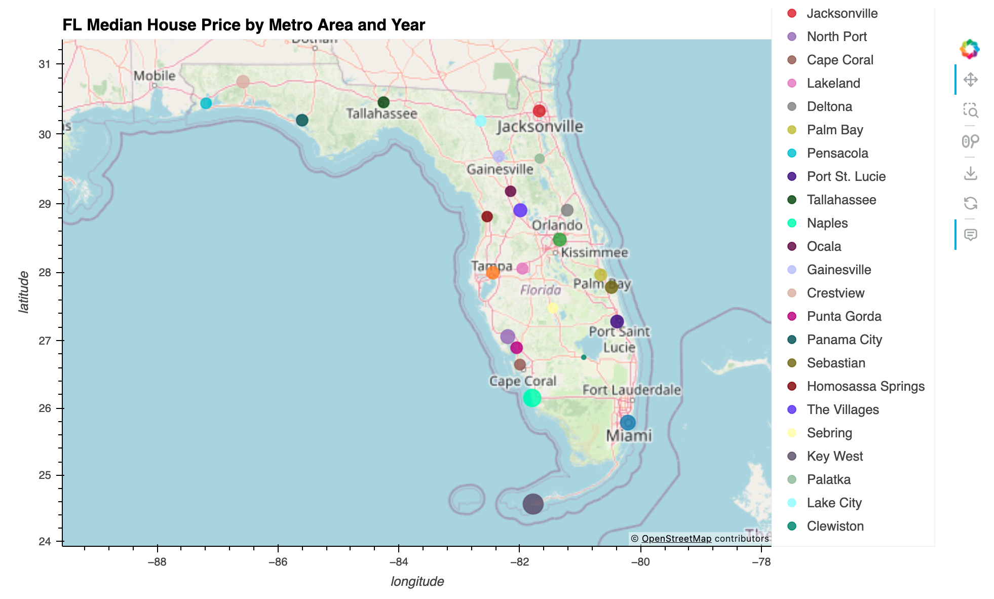
FLORIDA MEDIAN HOUSE PRICE BY METRO (MSA)
2012
2023
Naples | 2012 - $261,000 | 2021 - $615,000 | 2023 - $727,500
Miami | 2012 - $180,250 | 2021 - $435,000 | 2023 - $530,000
Orlando | 2012 - $142,000 | 2021 - $360,000 | 2024 - $399,900

Slide 18
CORRELATIONS

Slide 19
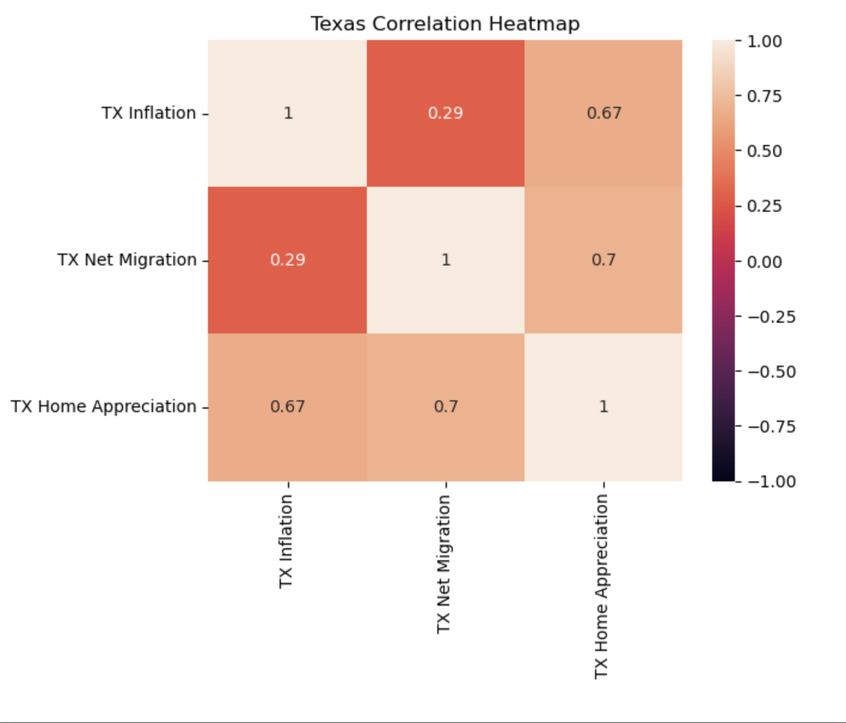
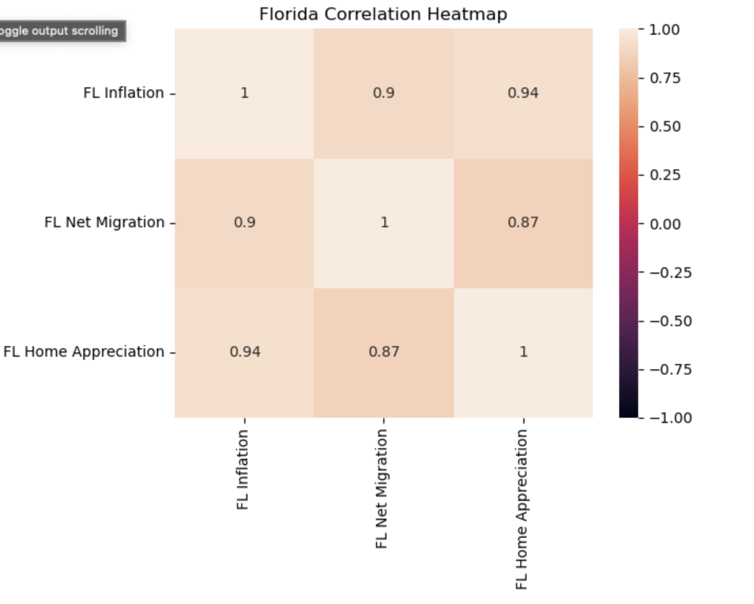
CORRELATIONS | TEXAS & FLORIDA

Slide 20
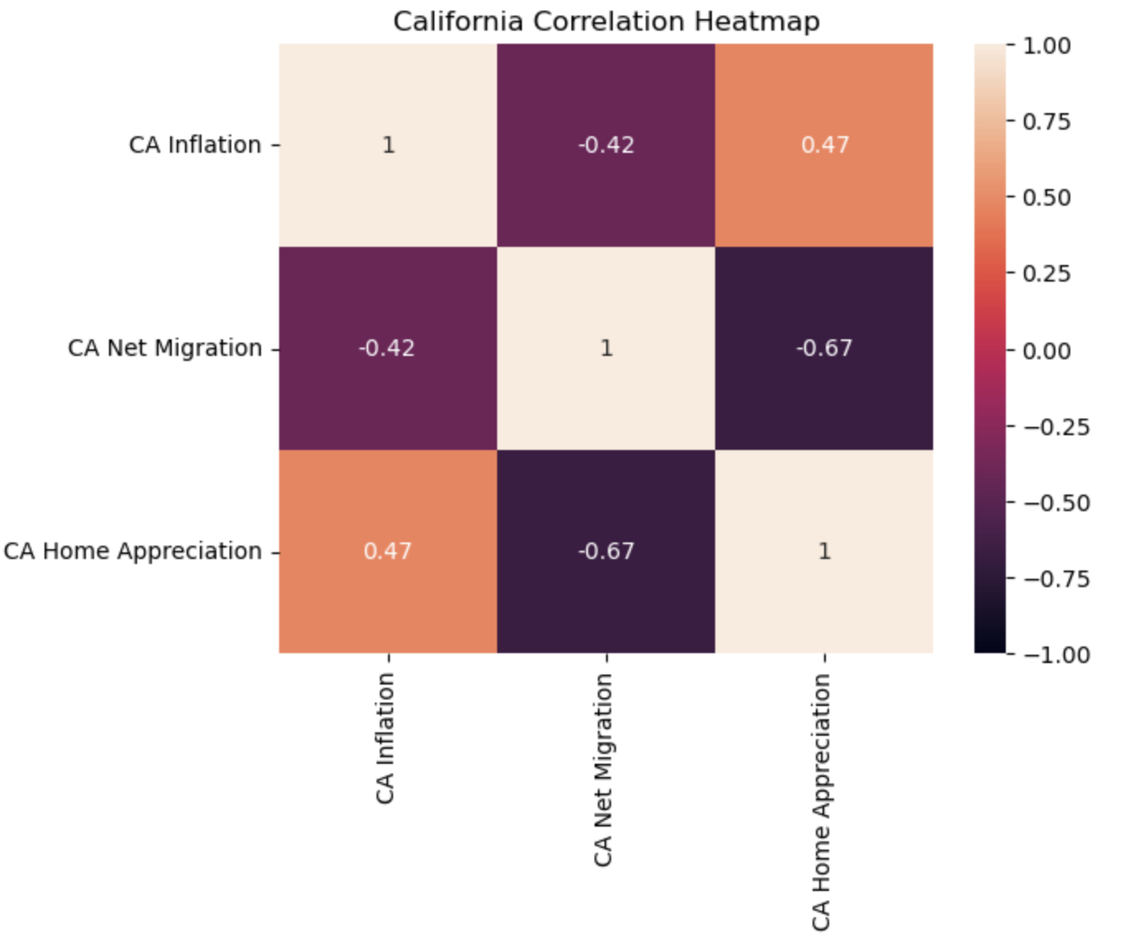
CORRELATIONS CALIFORNIA

Slide 21
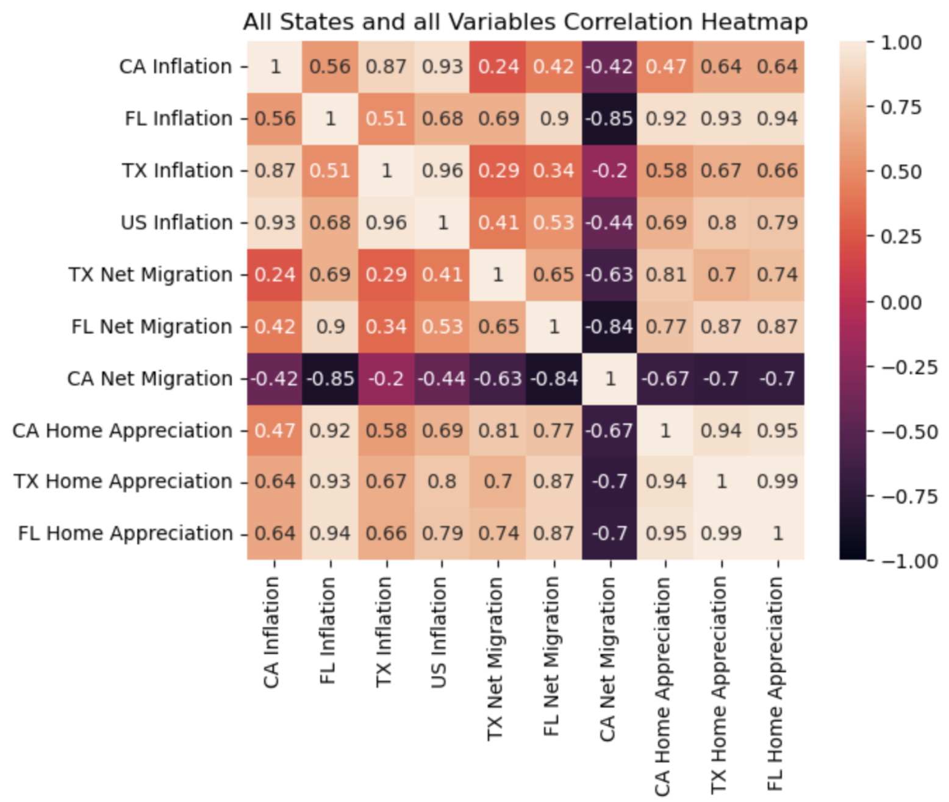
CORRELATIONS CA, FL, TX, & US

Slide 22
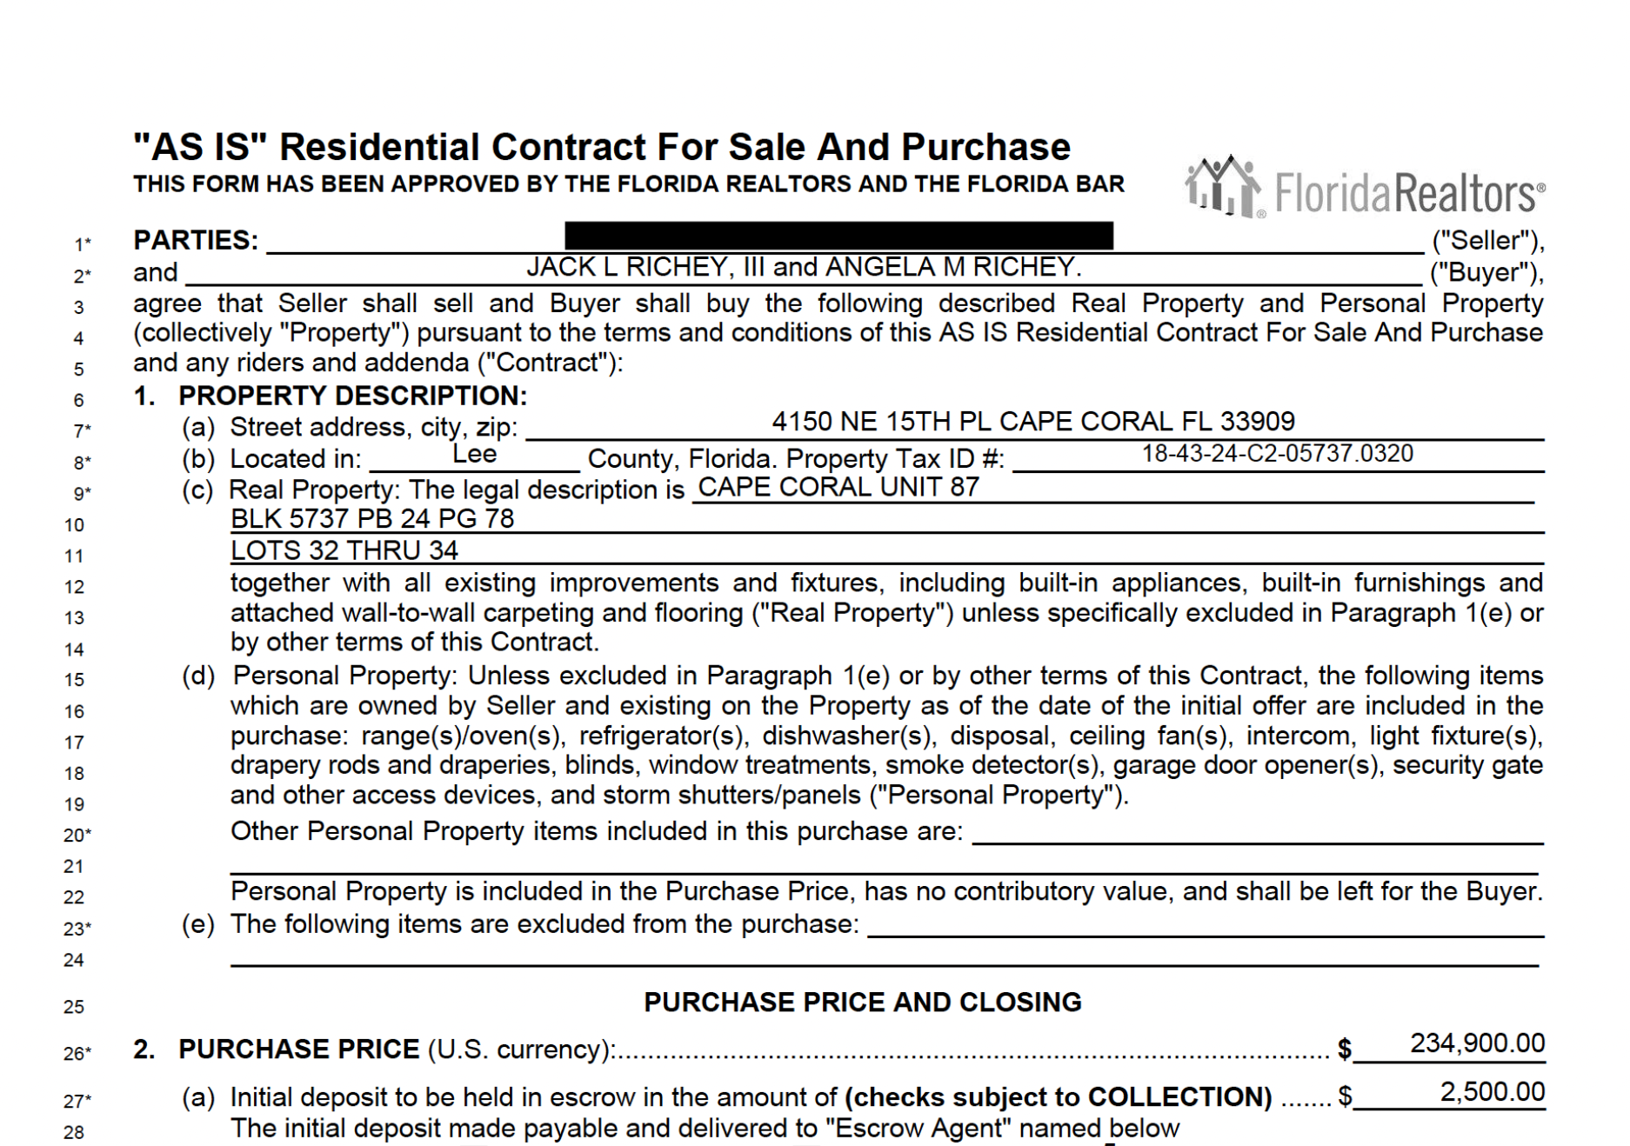
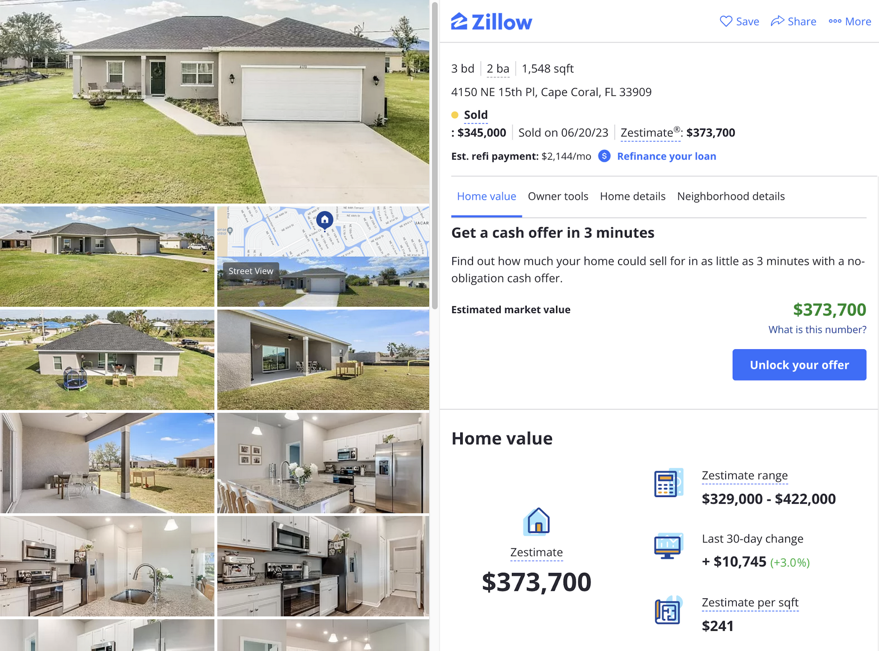
CASE STUDY: CAPE CORAL, FL

Slide 23
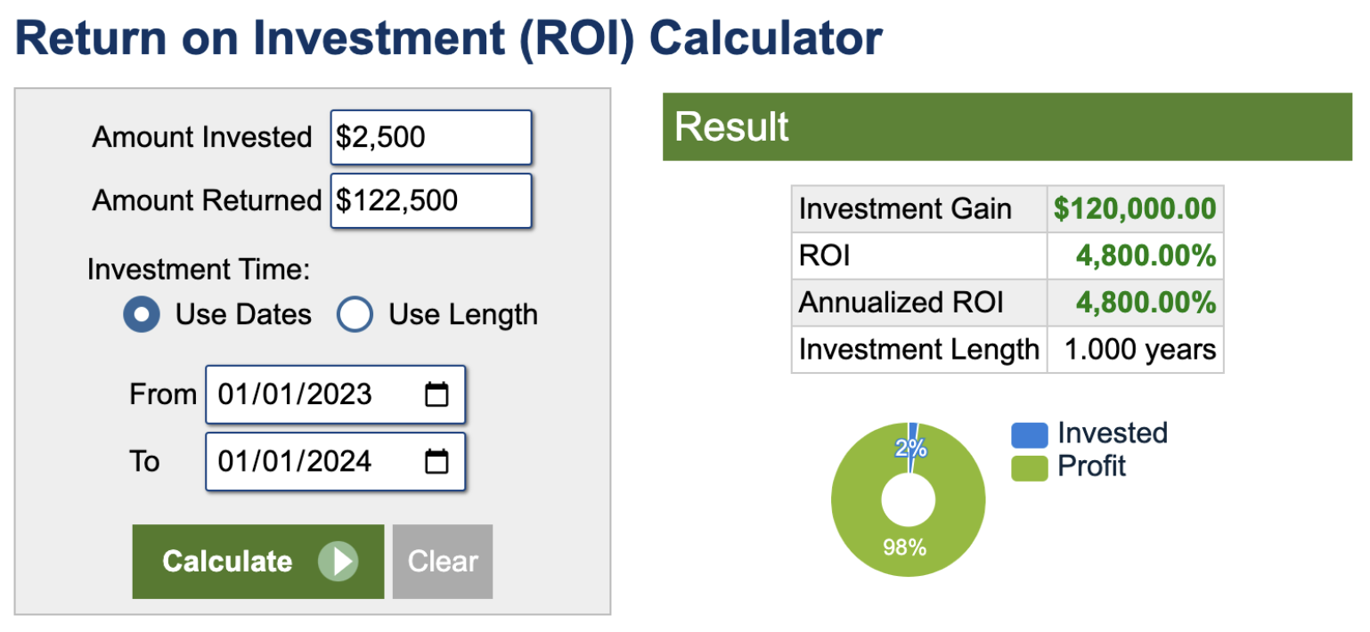
CASE STUDY: CAPE CORAL, FL

Slide 24
CONCLUSION

Slide 25

SUMMARY OF CONCLUSIONS
The roller coaster continues!
These variables are still volatile
Texas and Florida (southeast in general) have outpaced national migration averages
Correlated to respective rise in inflation and home values
People have been leaving California since the beginning of our study from 2012
This has not correlated to inflation rates and home values but is likely part of a complex causality
Case Study
Inflation drives up the cost of construction materials and skilled labor
Extraordinary migration creates housing market demand pressure
Demand pressure creates a supply shortage which can affect house prices

Slide 26
Questions…

